Slide 1
RTGI using rasterization
Che Sun

Slide 2
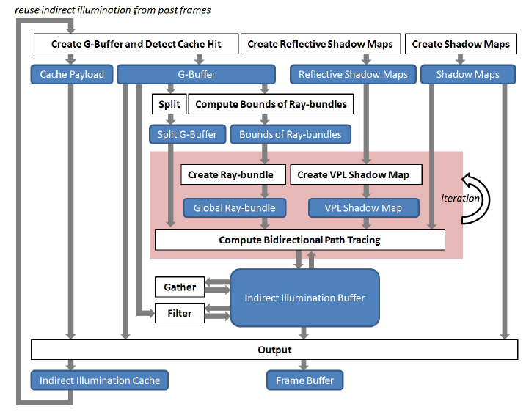
System Architecture

Slide 3
Hierarchical View of Technique Dependencies
Voxel-based Hybrid RTGI
Sampling and Reconstruction
Indirect Illumination
Direct Illumination
Interleaved Sampling
Frame Coherence Cache
Bidirectional Path Tracing
Direct Shadow using Rasterization (Regular Shadow Maps)
Direct Lighting Deferred Shading
G-Buffer Split
Instant Radiosity using Rasterization
Global Ray-bundles using Rasterization
Cubemap Shadow Maps
G-Buffer Creation
Scene Light RSMs Creation
Ray-bundles BV Computation using Compute Shader
Ray-bundles Creation and Shading
Caustics Maps
Indirect Illumination Buffer Creation and Filtering
VPL Creation and Shading
GPU Concurrent Linked List
VPL Visibility Test
Voxel-based Ray-bundles
Shader Atomic Operations
Shader Generic
Buffer
VPL Shadow Maps (Paraboloid Mapping)
Scene Voxelization
Implemented techniques
Imperfect Shadow Maps
Scene Geometry Tesselation
Unimplemented techniques
System Bottle Necks
Our Improvements

